Slide 1
Flipping in chemistry – lessons for mathematics

Slide 2

Contemporary versus traditional?
Notes:
Tremendously efficient
Inspiring
Or is that just defense of the lecture theatre, perhaps even the ‘lecturer’?

Slide 3

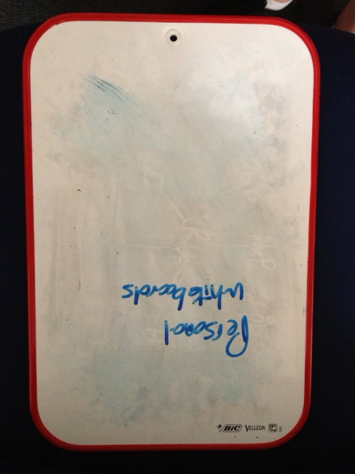


Our model of lecture flipping
Students are strongly encouraged to watch a screencast recording of the (previous year’s) lecture the flipped lecture is replacing.
They attend the timetabled teaching slot and are engaged in as interactive and as ‘challenging’ a session as the ‘lecturer’ can muster using every audience participation device at their disposal.

Slide 4
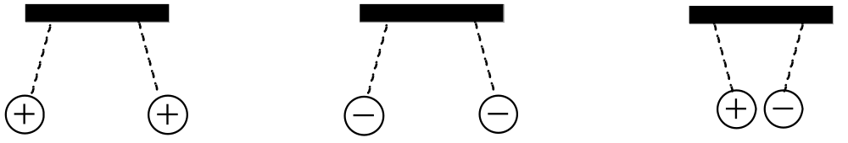
Opposites attract, like repels like

Slide 5
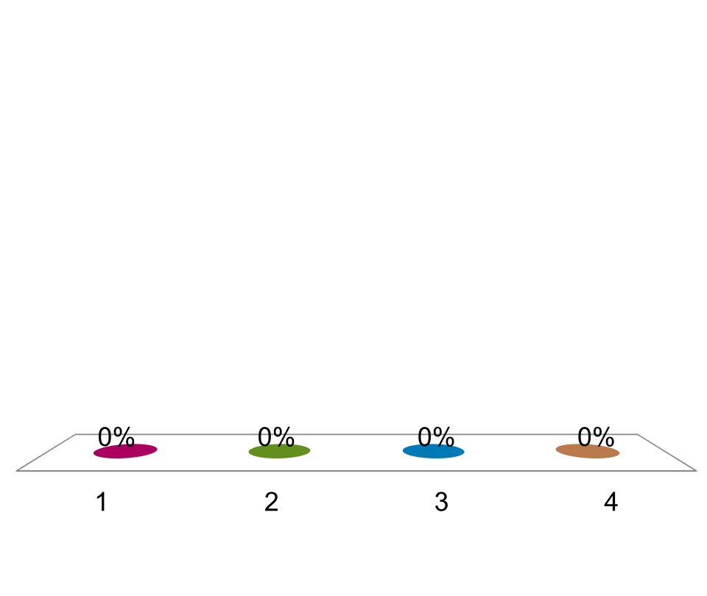
Which is favourable?
Li → Li⁺ + e⁻
Li⁺ + e⁻ → Li
Li⁺ → Li²⁺ + e⁻
Li⁻ + e⁻ → Li²⁻

Slide 6
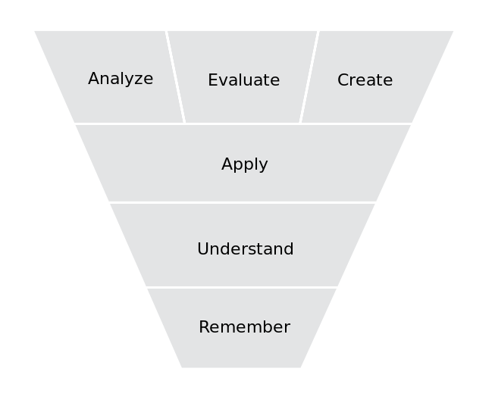
The importance of the question
Notes:
‘Bloom’s Taxonomy’ source:http://upload.wikimedia.org/wikipedia/commons/thumb/9/9e/BloomsCognitiveDomain.svg/653px-BloomsCognitiveDomain.svg.png

Slide 7
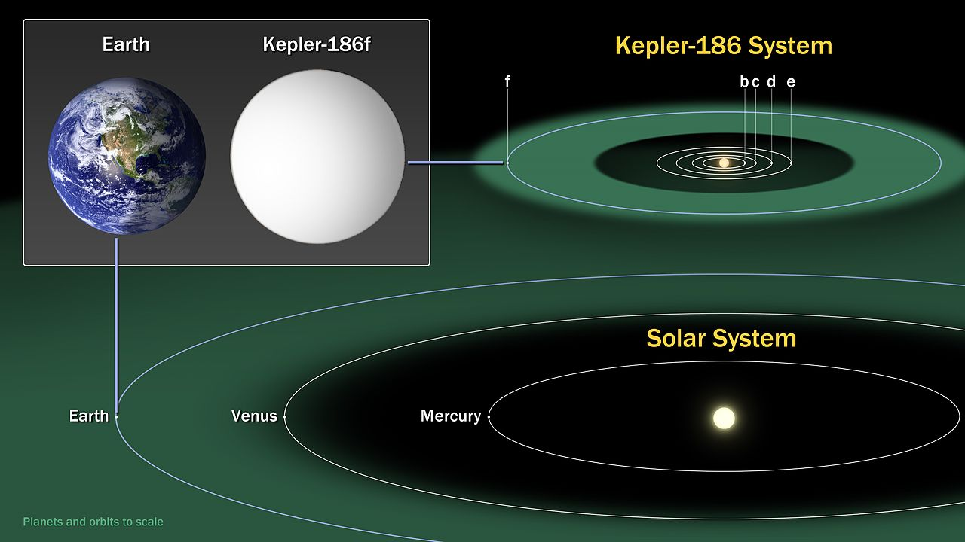
The Goldilocks Zone
Notes:
Kepler186f-ComparisonGraphic-20140417 improvedPublic Domain
NASA Ames/SETI Institute/JPL-Caltech - This file was derived from: Kepler186f-ComparisonGraphic-20140417.jpg

Slide 8
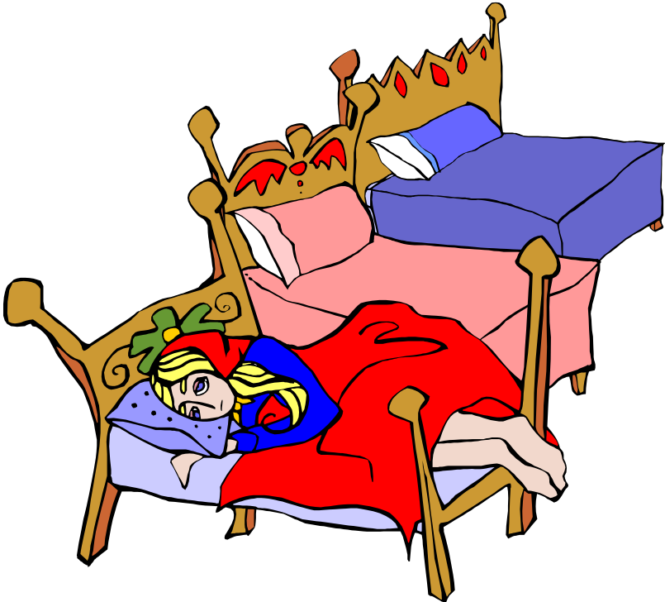
Who is best placed to determine the Goldilocks Zone?
Notes:
Clip art

Slide 9
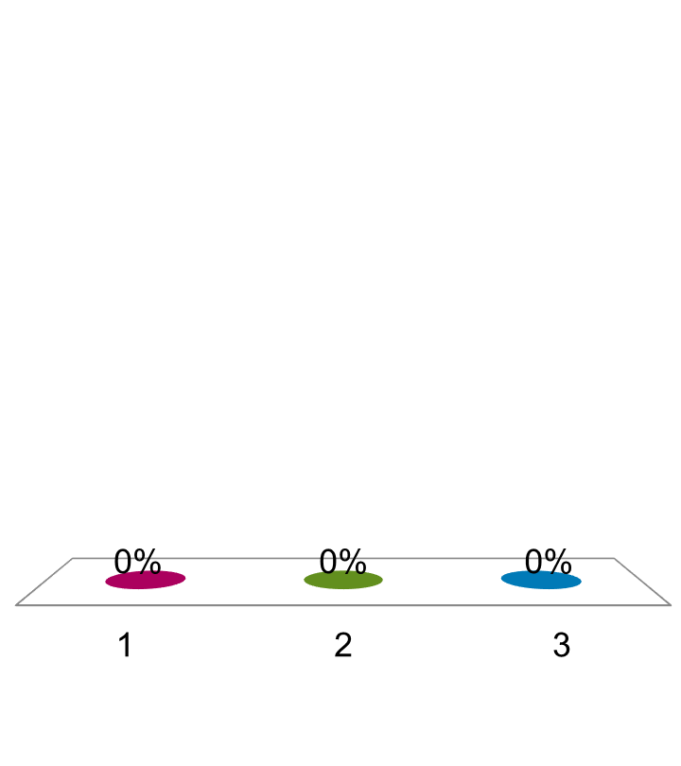
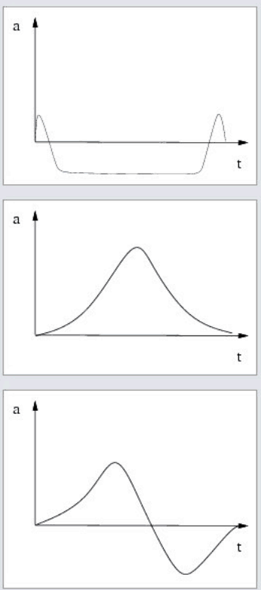
A ball initially at rest in the hand, is thrown upwards, comes back down and is caught.
Which of the following represents a plausible graph of vertical acceleration against time?
Graph 1
Graph 1
Graph 2
Graph 3
Graph 2
Graph 3

Slide 10
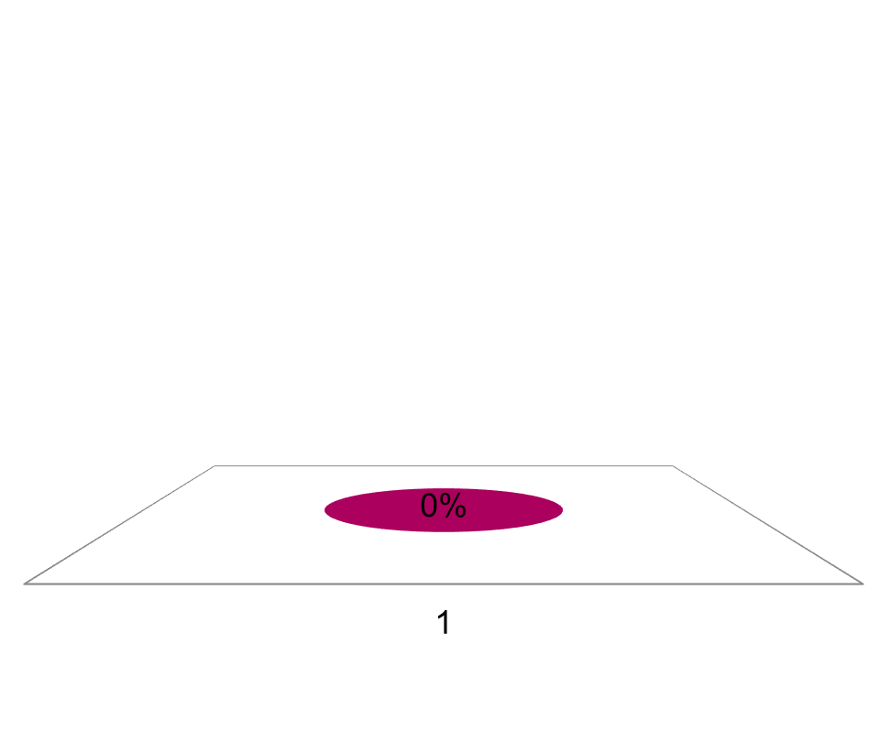
When you lose fat due to exercise how does it exit the body?
Rank | Responses
1
2
3
4
5
6

Slide 11
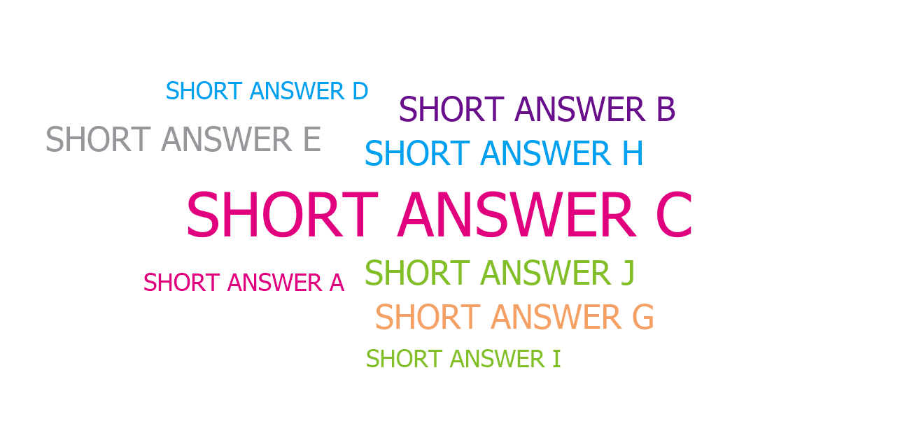
When you lose fat due to exercise how does it exit the body?

Slide 12
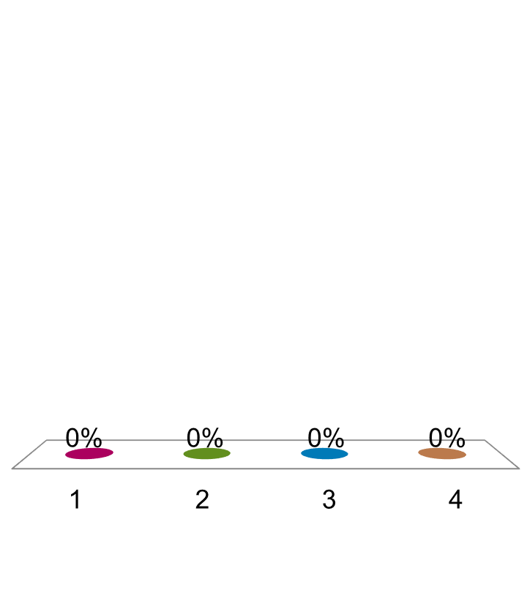
When you lose fat due to exercise how does it exit the body?
Defecation
Urination
Perspiration
Exhalation

Slide 13
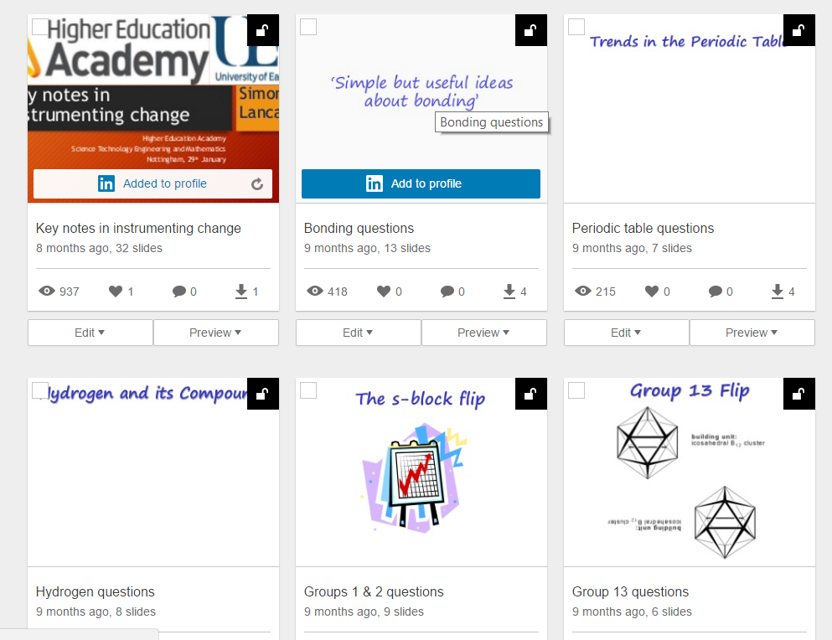
Open Educational Practice: Share Your Questions
Notes:
Slideshare.net

Slide 14

Peerwise
Notes:
Web page

Slide 15

ACKNOWLEDGEMENTS
Dr Adam Longcroft
Dr Fabio Arico
Jo Bruce
Andy Mee
Alicia McConnell
Prof Eric Mazur
Dr Anne Nortcliffe
Dr Ross Galloway
Dr Anna North
Turning Technologies
Notes:
1- Bloom, B.S., 1984,Taxonomy of Educational Objectives Book 1: Cognitive Domain 2nd Edition, Addison-Wesley publishing company.
2-Krathwohl, D.R, 2002, Revising Blooms Taxonomy an Overview, Theory Into Practice, 41, 214-216.
3- Arico, F.R., Thomson, C, University of East Anglia, 2014, When student confidence clicks: Academic self-efficacy and learning in higher education,
http://www.st-andrews.ac.uk/media/teaching-and-learning/documents/Fabio%20R%20Arico%20-%20Self-Efficacy.pdf
4- Kruger. J., Dunning. D.,1999, Unskilled and Unaware of it: How Difficulties in Recognising One’s Own Incompetence Leads to Inflated Self- Assessments, Journal of Personality and Social Psychology,77, No, 1121-1134.

Slide 16
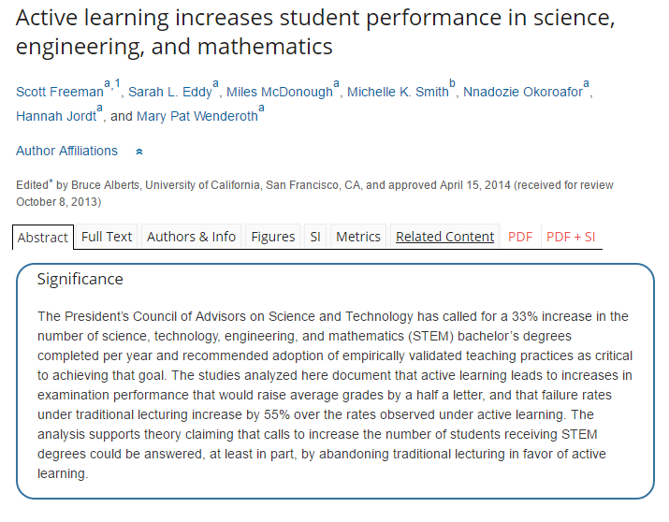
4* evidence

